Slide 1

ISDS 552 GP3
TEAM MEMBERS:
DEEPAM KHIRWAR
HARSHITA DIDWANIA
KAVINDU WALIMUNIGE
SANCHIT SINGH
SATHIYA PRIYA JEEVANANDAN

Slide 2
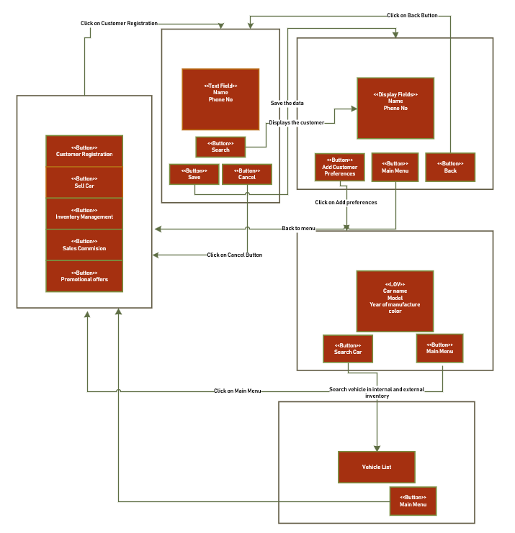
WND- match customer with vehicles

Slide 3
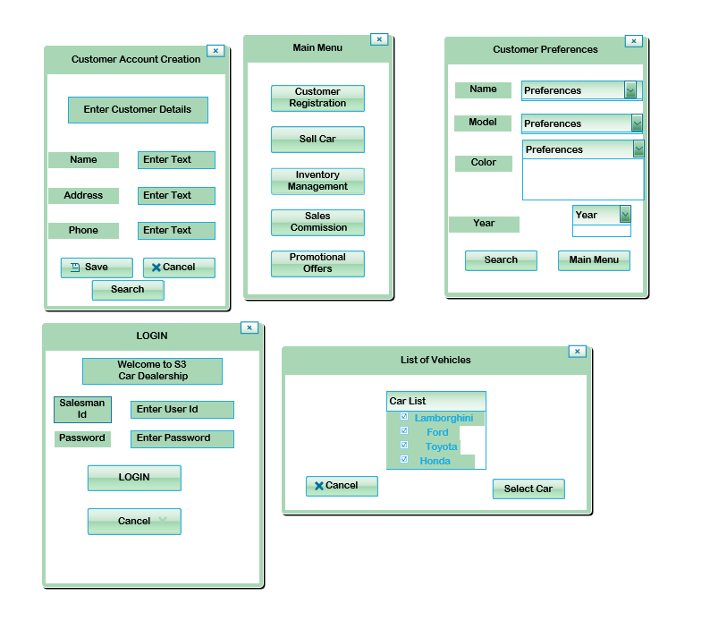
GUI- Match Customer with Vehicles

Slide 4
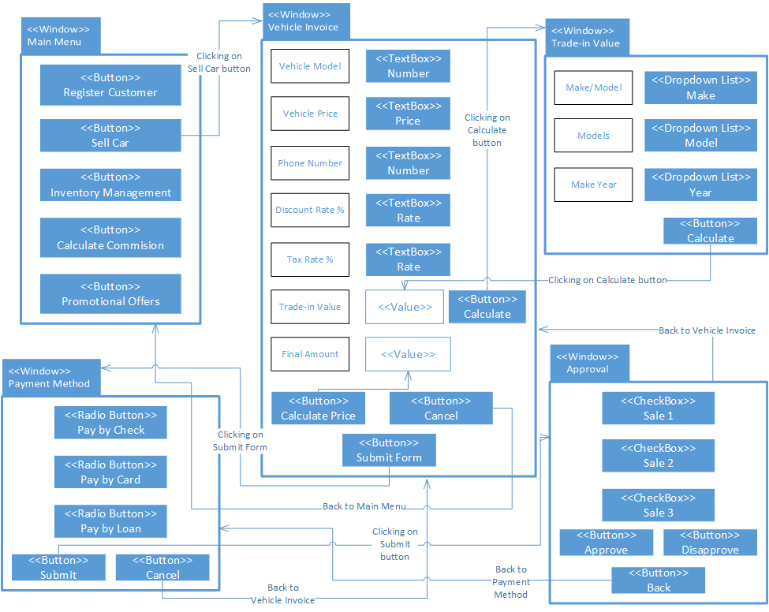
WND- Sell Car

Slide 5
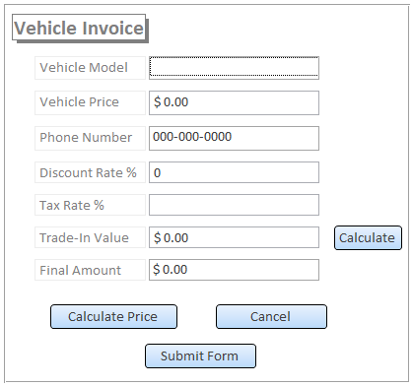
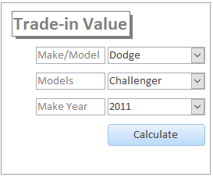
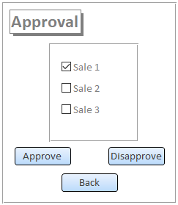
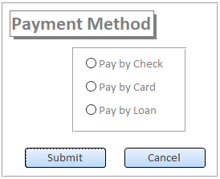
GUI- Sell Car
1
2
4
3

Slide 6
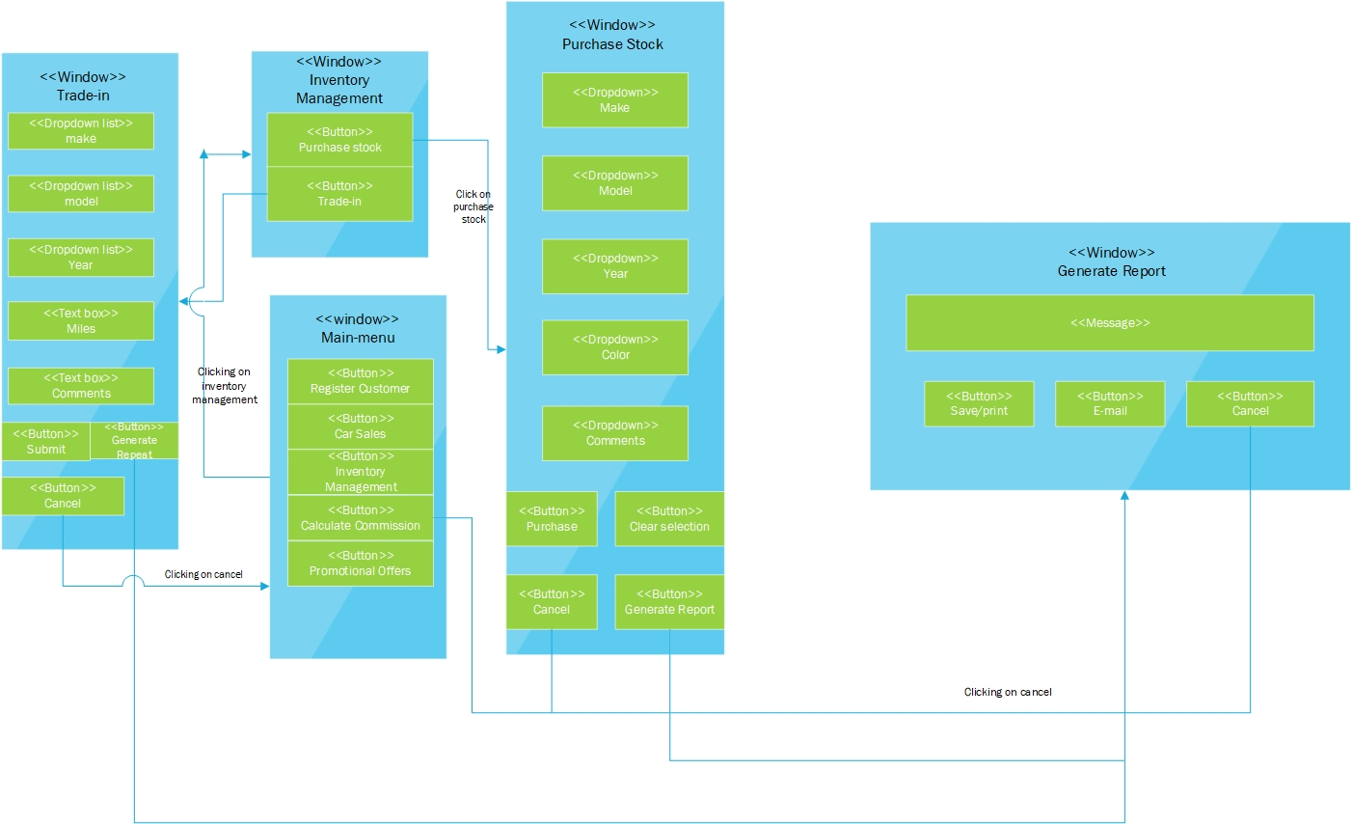

WND – Managing Inventory

Slide 7
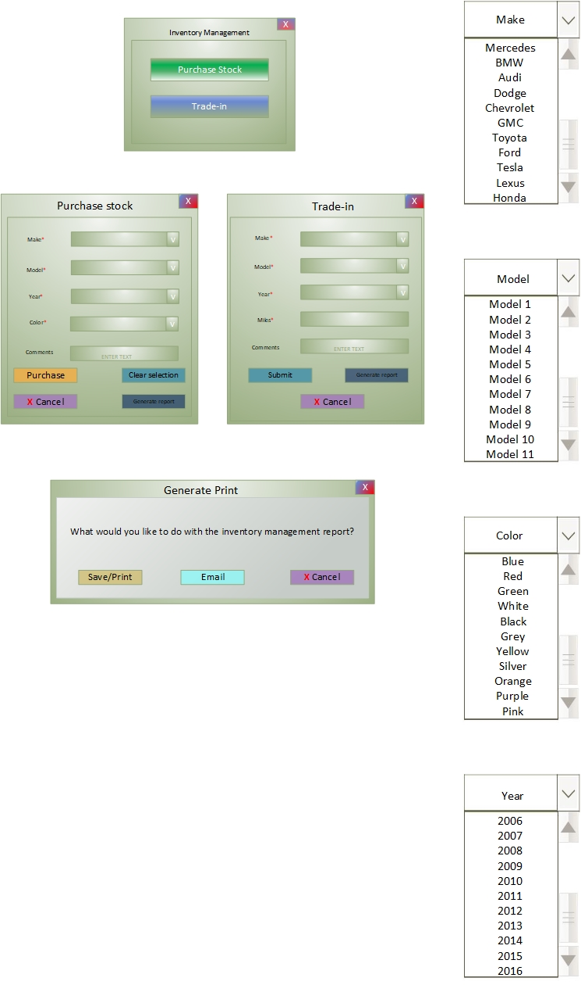
GUI – Managing Inventory

Slide 8
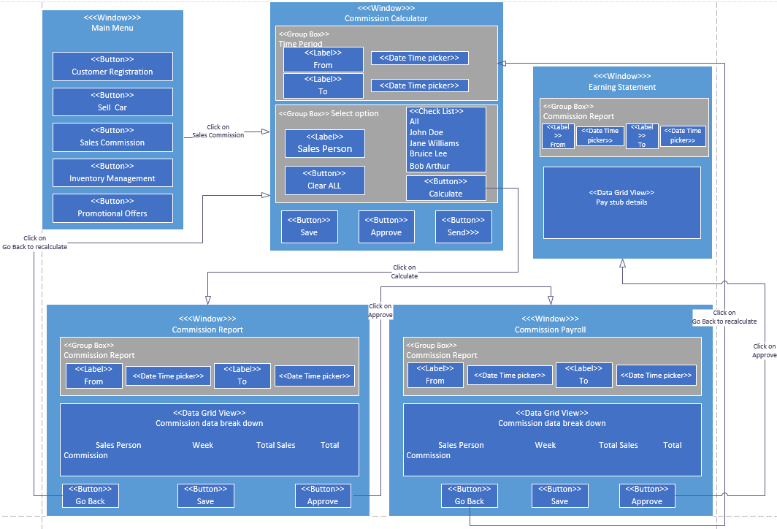

WND - Sales Commission

Slide 9
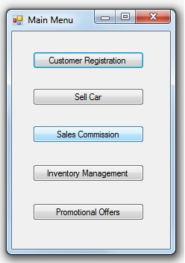
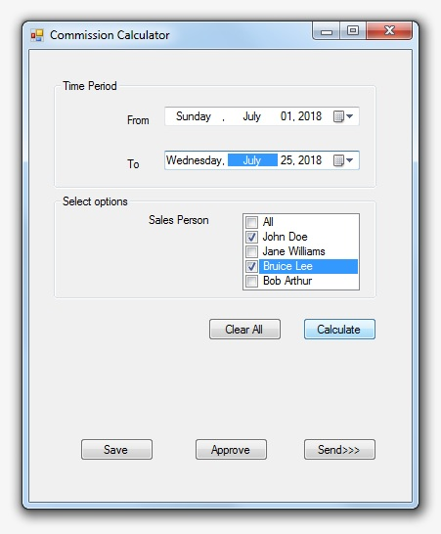
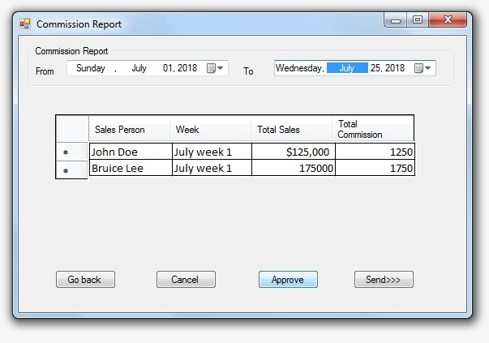
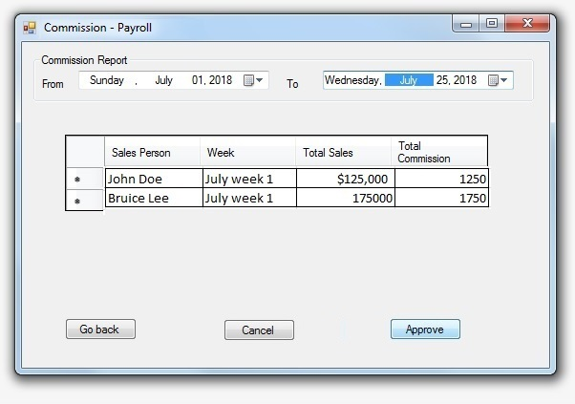
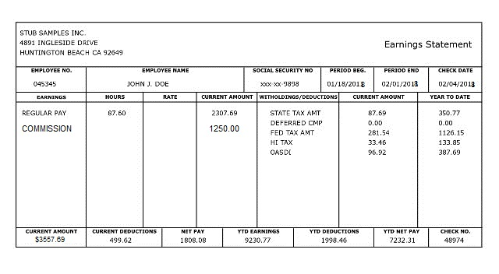
GUI - Sales Commission

Slide 10
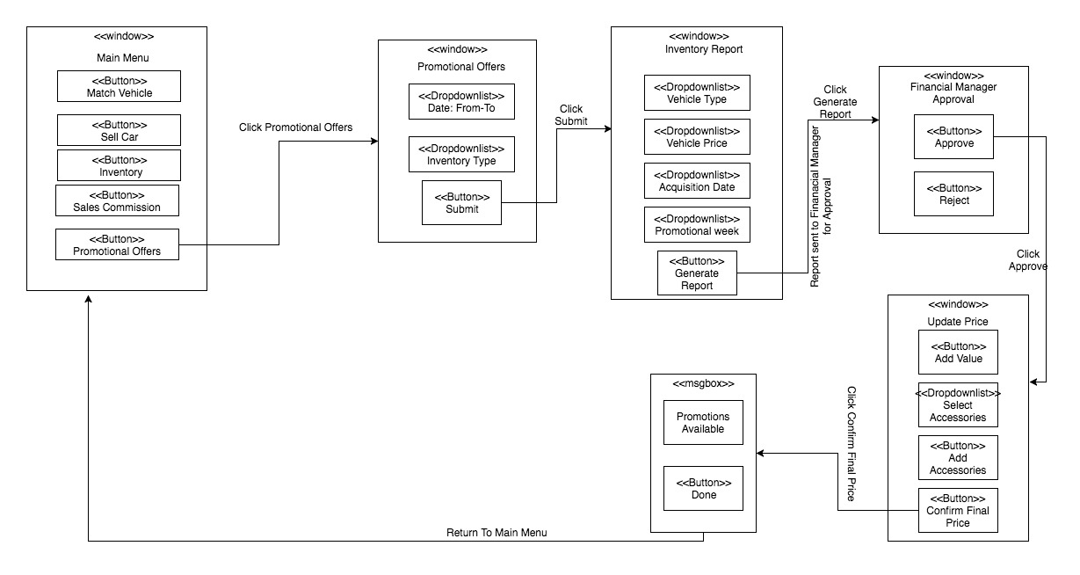
WND- Identify promotional offers

Slide 11
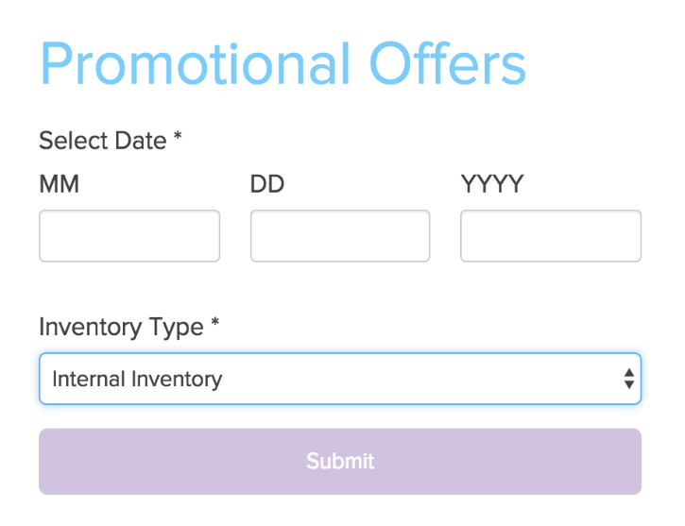
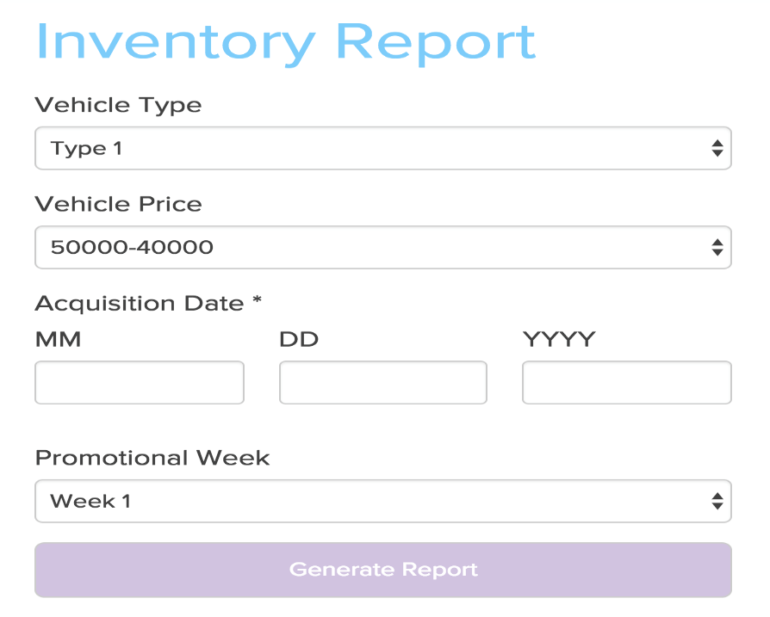
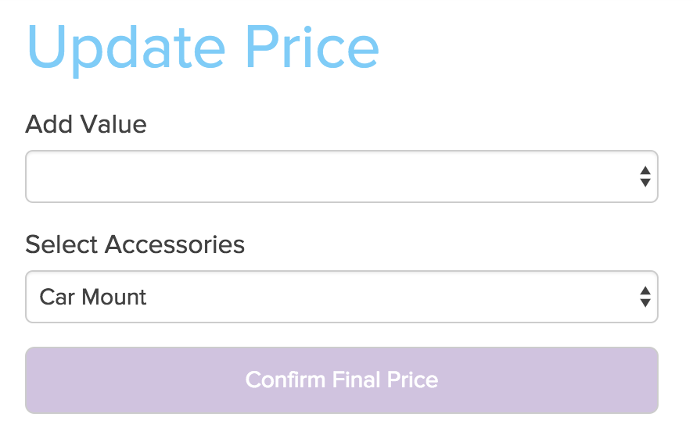
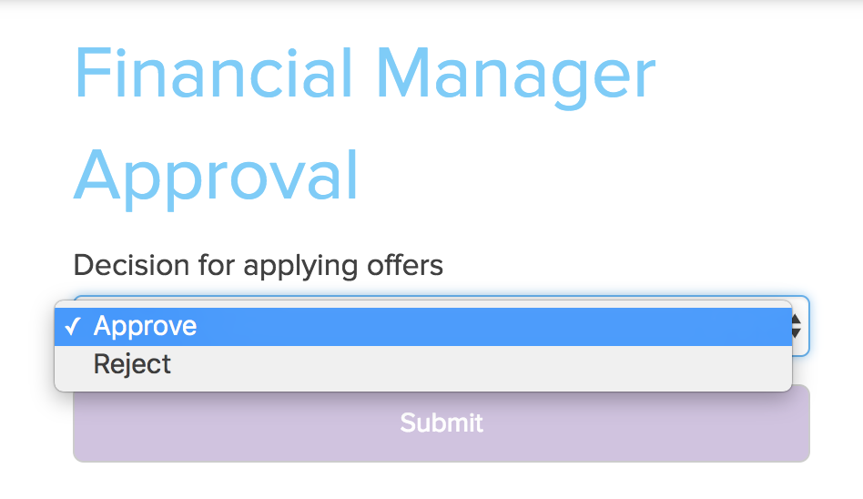
GUI - Identify promotional offers

Slide 12
End of presentation
Thank you!

